Slide 1
EC2 Instances Summary

Slide 2
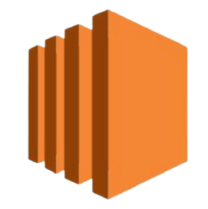
EC2
EC2 Stands for Amazon Elastic Compute Cloud.
An Amazon web service provides configurable compute capacity in the AWS cloud.

Slide 3
EC2
It provides Infrastructure as a Service (IaaS).
Control over your computing resources.
EC2 is based on the server virtualization concept
Computing power of server hardware is divided into different instances
Provided to the end-user.

Slide 4
EC2 Instance
A virtual server that runs applications on Amazon's EC2.
As a small part of a larger computer,
Hard drive.
Network connection
Operating system, and so on.

Slide 5
EC2 Instance
On a single physical machine, we can run multiple small computers, which are referred as Instances.
Amazon EC2 is very useful to use
users can scale up or down easily.

Slide 6
EC2 Instances Features
EC2 Instances are extremely safe to use.
Use various instances as per our needs.
With a firewall as the ports, protocols and IP range.

Slide 7
EC2 Instances Features
Our instances remain safe,
key pairs,
accessed by the key pairs only.
Store data on our instances by configuring Amazon EBS volumes with the instances.

Slide 8
Advantages
Auto-scaling.
Pay-as-you-go.
Increased Reliability.
Elasticity.

Slide 9
Important EC2 Terms
EC2 Dashboard:
It gives the users an overview of their EC2 usage in a particular region.
EBS Volumes:
These volumes function similarly to hard discs in the cloud.
They can be linked to our Amazon EC2 instances.

Slide 10
Important EC2 Terms
Types of EBS Volumes:
General Purpose SSD (gp2).
Provisioned IOPS SSD-backed volumes.
HDD-backed volume.

Slide 11
Important EC2 Terms
Snapshots:
To create backups of your EBS volumes.
To generate multiple EBS volumes containing identical data.

Slide 12
Important EC2 Terms
Network Interfaces
They can be created and attached to EC2 instances.
A single instance can have multiple network interfaces attached to it.

Slide 13
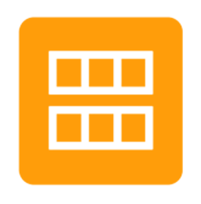
AMI
An Amazon Machine Image (AMI) is used to create virtual servers.
To set up an instance than traditional software deployments.
No manual setup.
Configuration.
Additional hardware.

Slide 14
Different Instance Types
On-Demand Instances:
We pay for compute capacity.
There are no long-term commitments.
We don’t need to make advance payments.

Slide 15
Different Instance Types
Reserved Instances:
Use a reduced price billing concept.
Acquire significant discounts compared to standard "On Demand".
Discount is offered to users when they use these instances.

Slide 16
Spot Instances
Spot instances:
To reduce your EC2 on-demand instance costs by up to 90%.
By an increasing number of businesses.
SMBs to enterprises for mission-critical and production workloads.

Slide 17
Instances use case
General-purpose Instances:
Used for web servers, development environments, and so on.
Include T and M instance types they are good for changing and consistent workloads.

Slide 18
Instances use case
Optimized for compute:
Compute-intensive applications,
Scientific modeling
High-performance web servers.
Include C instances they are good for high processing and used in busy web servers.

Slide 19
Instances use case
Memory-Optimized:
Used for applications that require a lot of memory
Real-time big data analytics
Running Hadoop or Spark.
Include r and x instance types.
For databases, real-time analytics and uses the AWS Nitro System.

Slide 20
Instances use case
Accelerated computing:
Additional hardware (GPUs, FPGAs).
Massive amounts of parallel processing for tasks such as graphics processing.
Include P, G and F instances.
For machine learning, used in graphic processing and big data respectively.

Slide 21
Instances use case
Storage Optimized:
Ideal for tasks requiring large amounts of storage
Sequential read-write - Log processing.
Include D and t3 instances.
For SSD backed instances.
Used for the Largest SSD offerings.

Slide 22
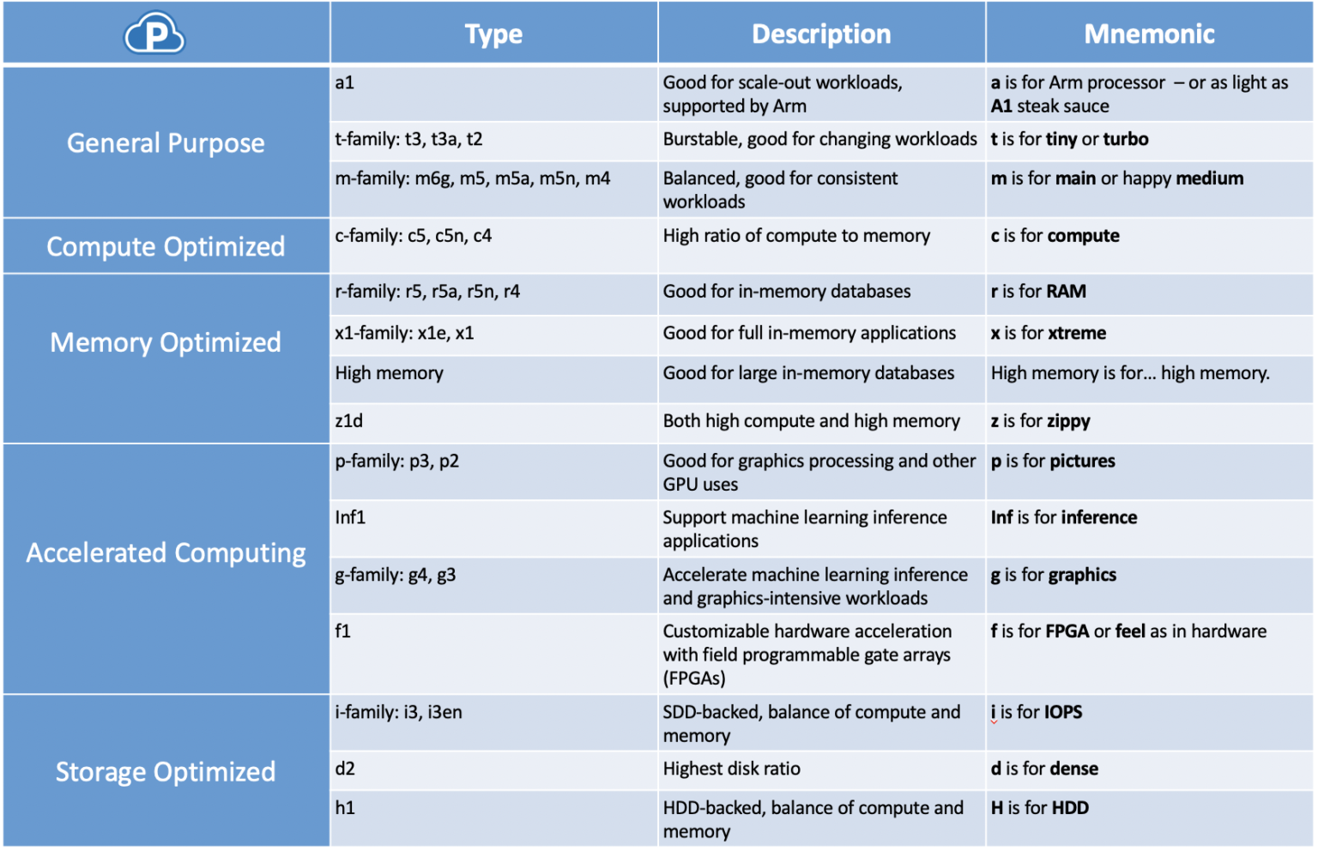

Slide 23
SSH
Secure Shell or Secure Socket Shell.
Access a computer securely.
Refer to a suite of utilities.
Addition to providing secure network services.

Slide 24
SSH
Secure Shell supports
Strong password.
Public key authentication.
Encrypted data communications.
Connected via an open network such as the internet.

